Slide 1


CLASSIFYING PROTEIN SEQUENCES USING
PROBERT
SRIRAM.K 221501144
TARUN SAI N.S 221501159

Slide 2
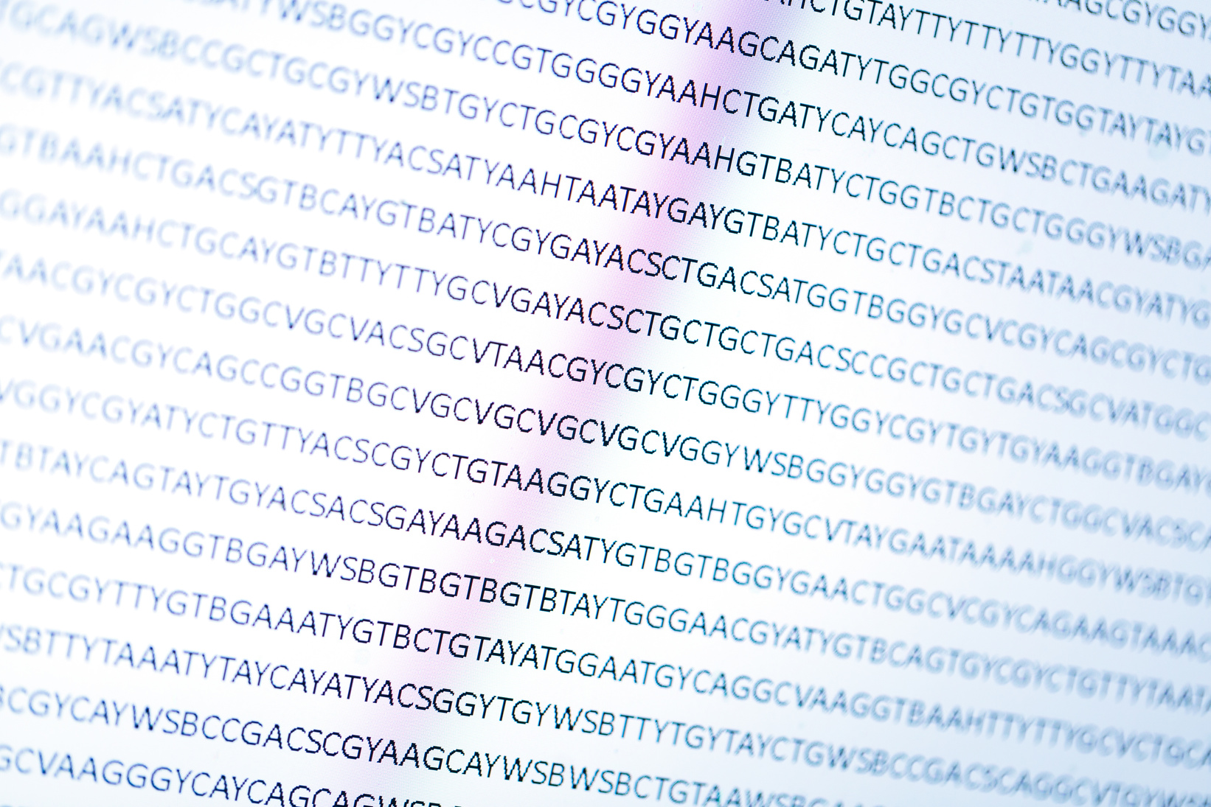
INTRODUCTION
Proteins are essential biomolecules that govern nearly all biological processes through their structure and function.
Understanding the relationship between protein sequences (amino acids) and their functions, structures, and interactions is crucial in fields like bioinformatics and drug discovery.
Traditional methods of analyzing protein data can be time-consuming and computationally expensive.
The advent of ProBERT, a transformer-based model pre-trained on protein sequences, offers a new approach to efficiently predict protein functions, interactions, and the impact of amino acid substitutions.
This project aims to fine-tune ProBERT for specific tasks in protein analysis, enabling faster and more accurate insights into protein-related phenomena, ultimately advancing research in molecular biology and medicine.

Slide 3

PROBLEM STATEMENT
Analyzing protein sequences to predict their function, interactions, and the effects of amino acid substitutions is a complex and computationally expensive task. Traditional methods often rely on labor-intensive experiments or slow computational techniques. With the growing volume of biological data, there is a need for more efficient and accurate approaches. This project aims to utilize ProBERT, a transformer model pre-trained on protein sequences, to enhance the prediction of protein functions, protein-protein interactions, and the impact of mutations. By fine-tuning ProBERT for these tasks, the project seeks to streamline protein analysis, making it faster and more accessible, thereby supporting advancements in bioinformatics, drug discovery, and disease understanding.

Slide 4

Building a Strong Team
01
ProBERT to Protein Function Prediction:
02
Predict Protein-Protein Interactions
Fine-tune the ProBERT model to predict protein functions accurately from amino acid sequences.
Utilize ProBERT to predict potential interactions between proteins based on their sequences.
03
Assess the Impact of Amino Acid Substitutions
04
Enhance Bioinformatics Research
Use ProBERT to predict how mutations in amino acid sequences affect protein stability, structure, and function.
Develop an efficient, scalable model to accelerate protein sequence analysis and contribute to fields like drug discovery and disease research.

Slide 5
SCOPE OF THE PROJECT
01
Protein Sequence Analysis
TPredicting protein functions, protein-protein interactions (PPIs), and the effects of amino acid substitutions.
02
Data Sources
utilize publicly available datasets, such as UniProt, PDB, and DIP, to train and evaluate the ProBERT model.
03
Automated Bioinformatics Tool
The outcome will be an automated tool for faster protein sequence analysis, contributing to bioinforma
04
Scalability
The model will be designed to handle large-scale protein data, making it applicable for broader bioinformatics applications.

Slide 6
No. | Title | Year | Authors | Summary
1 | AlphaFold: Using AI for Scientific Discovery | 2021 | John Jumper, et al. | Introduces AlphaFold, which predicts protein structures, complementing sequence-based models like ProBERT.
2 | ProtBERT: A Pretrained Language Model for Protein Sequence Classification | 2020 | Michael E. Rives, et al. | Presents ProtBERT, a transformer-based model for protein sequence classification and function prediction.
3 | DeepSeq: Predicting Protein-Protein Interactions from Sequence | 2020 | Jianlin Cheng, et al. | Utilizes deep learning models to predict protein-protein interactions (PPI) based on amino acid sequences.
4 | ProteinBERT: A Transformer-based Architecture for Protein Function Prediction | 2020 | Zhiwei Liu, et al. | Adapts BERT to predict protein functions directly from amino acid sequences.
5 | Learning Representations of Protein Sequences with Deep Learning | 2020 | David L. H. Liao, et al. | Explores deep learning methods for learning protein sequence representations to enhance bioinformatics tasks.

Slide 7
No. | Title | Year | Authors | Summary
6 | Sequence-based Predictive Models for Human Protein Function Annotation | 2019 | Rui Qian, et al. | Discusses sequence-based models for annotating protein functions, relevant to ProBERT's tasks.
7 | BERT: Pre-training of Deep Bidirectional Transformers for Language Understanding | 2018 | Jacob Devlin, et al. | Introduces BERT, a transformer-based model, which has been adapted for protein sequence analysis.
8 | DeepConvolutional Neural Networks for Protein Sequence Analysis | 2017 | Xueying Liu, et al. | Investigates the use of deep convolutional neural networks (CNNs) for protein sequence analysis.
9 | SIFT and PolyPhen: Predicting the Impact of Amino Acid Substitutions on Protein Function | 2009 | Ian P. Ng, et al. | Discusses tools to predict the effects of amino acid substitutions on protein function, related to mutation impact analysis.
10 | Computational Approaches to Predicting Protein-Protein Interactions | 2016 | Patrick G. S. M. G. Tominari, et al. | Reviews computational methods for predicting protein-protein interactions, relevant to ProBERT's PPI tasks.

